Slide 1
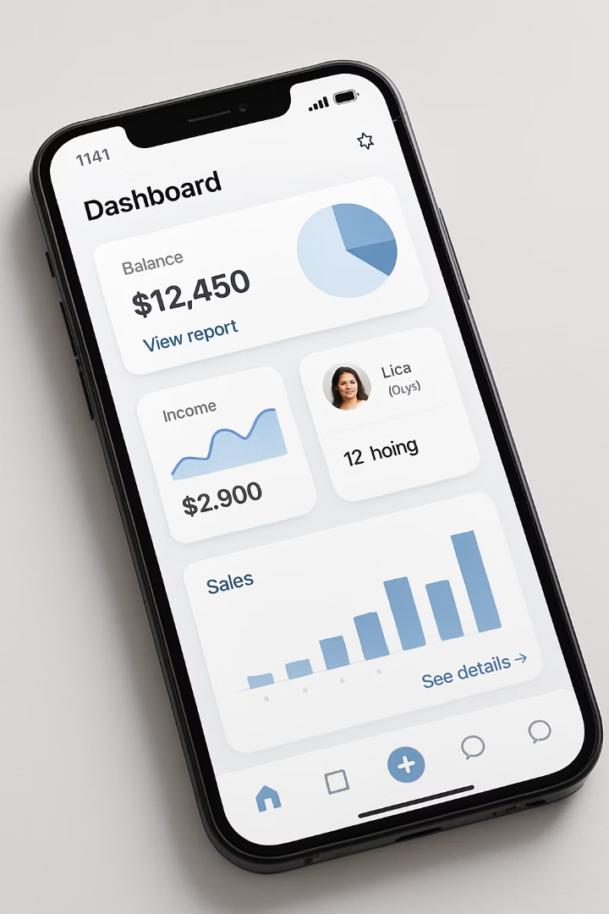

React Native Layout Mastery: Flexbox for Modern UIs
Unlock the power of Flexbox in React Native to create responsive, flexible layouts that adapt to any screen size.

Slide 2
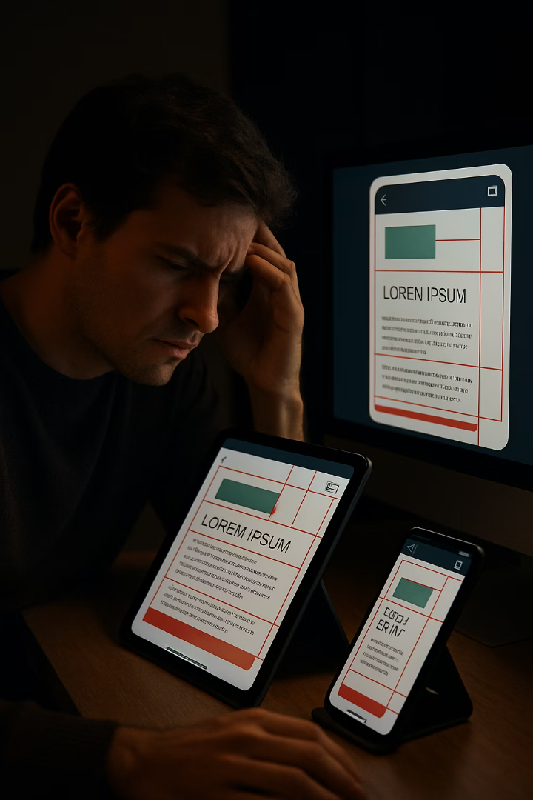



Understanding the Layout Challenge
Device Fragmentation
Positioning Complexity
Multiple screen sizes and resolutions across iOS and Android devices.
Manual positioning is tedious and breaks across different screens.
Responsive Needs
Apps must adapt to orientation changes and screen dimensions.

Slide 3
What is Flexbox?
A Flexible Layout Model
React Native Implementation
Flexbox is a powerful one-dimensional layout system that arranges elements along a single axis (either horizontally or vertically).
In React Native, Flexbox is the core layout engine with 'flex' being the default display style for all components.
Unlike web CSS, all container views in React Native automatically use Flexbox layouts, simplifying cross-platform UI development.
It offers intelligent space distribution and alignment capabilities that solve many common UI layout challenges efficiently.
Documentation: Layout with Flexbox · React Native

Slide 4
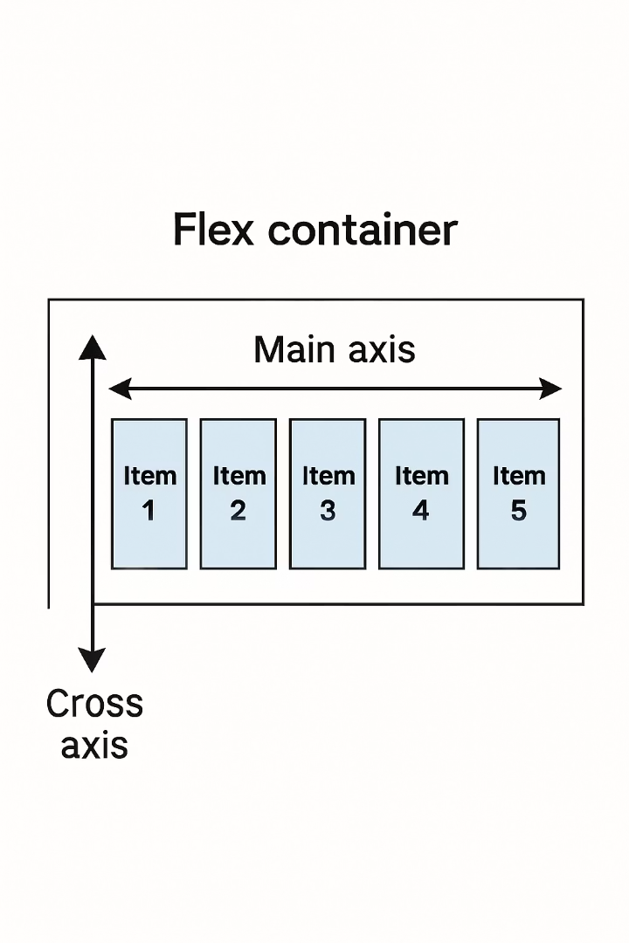
The Flex Container Model
Flex Container
Flex Items
The parent element that holds flex items. In React Native, any View can be a flex container.
The children of a flex container. They can be Views, Text, Images, or other components.
Main Axis & Cross Axis
The primary and secondary directions that items are arranged along. They change based on flexDirection.

Slide 5
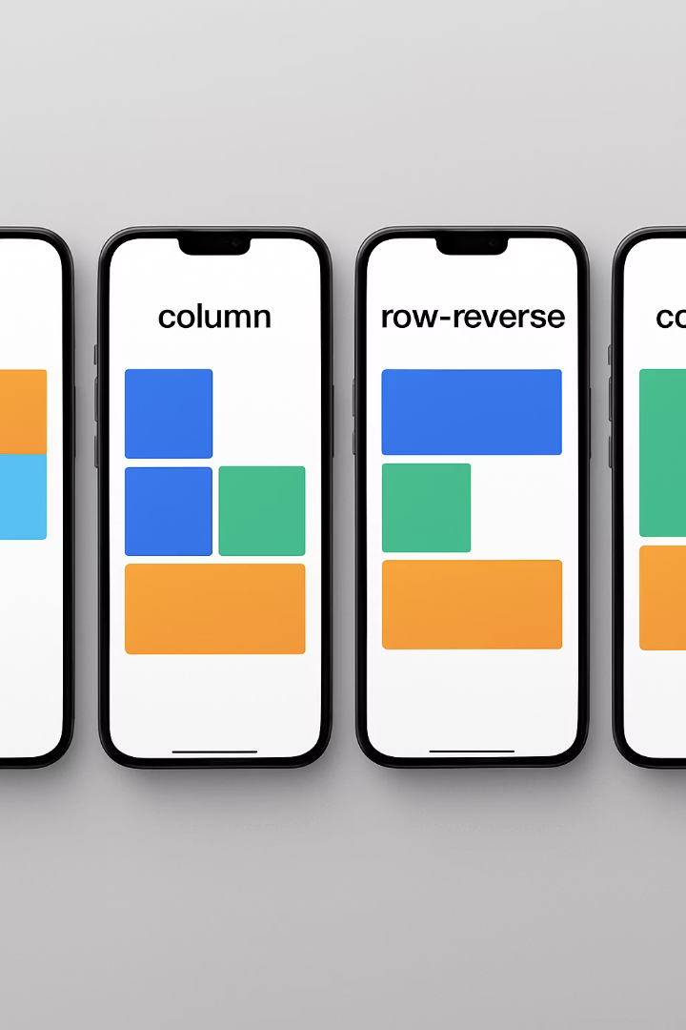
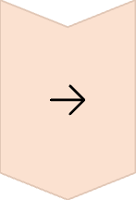
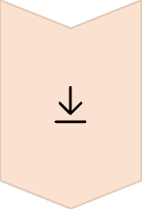
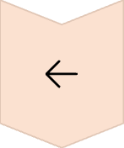
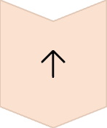
flexDirection Property
row
Items are placed horizontally from left to right (default in web, not in React Native)
column
Items are placed vertically from top to bottom (default in React Native)
row-reverse
Items are placed horizontally from right to left
column-reverse
Items are placed vertically from bottom to top

Slide 6
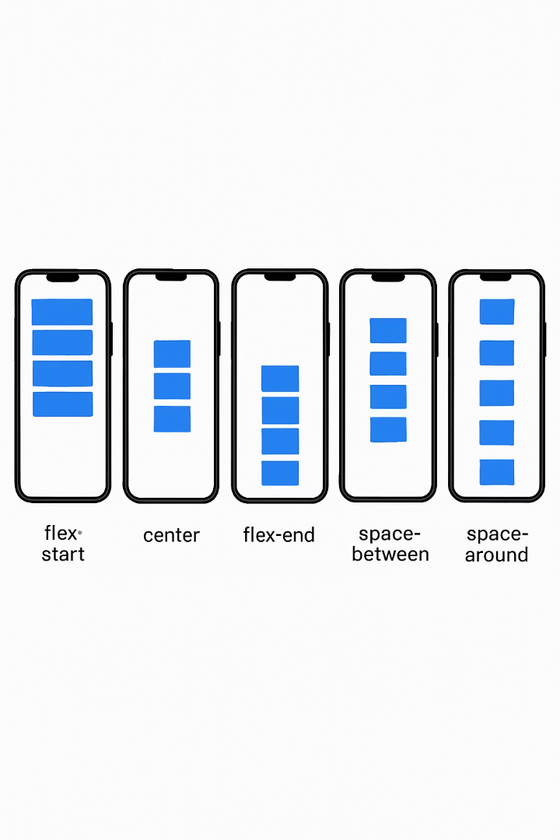




justifyContent Property
flex-start
Items are packed toward the start of the main axis
center
Items are centered along the main axis
flex-end
Items are packed toward the end of the main axis
space-between/around/evenly
Items are distributed with equal spacing in different ways

Slide 7

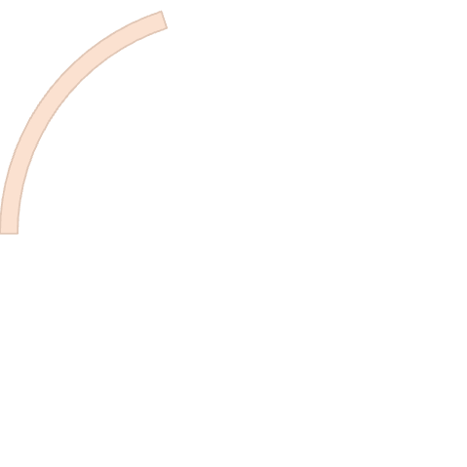
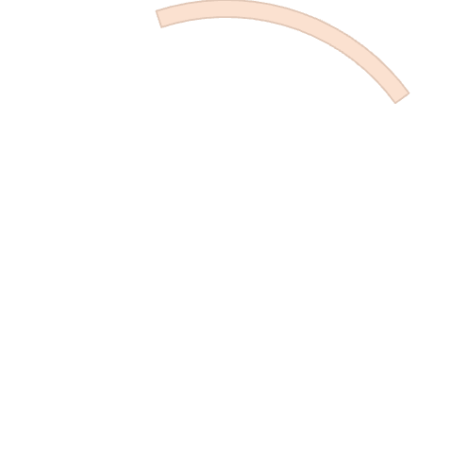
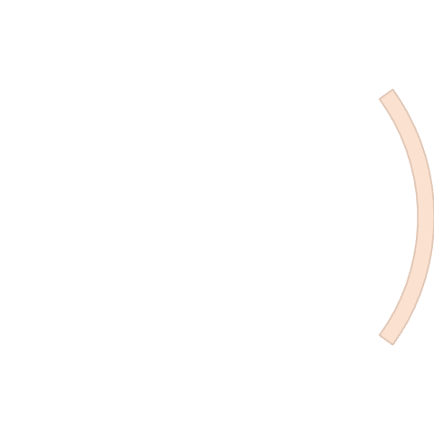
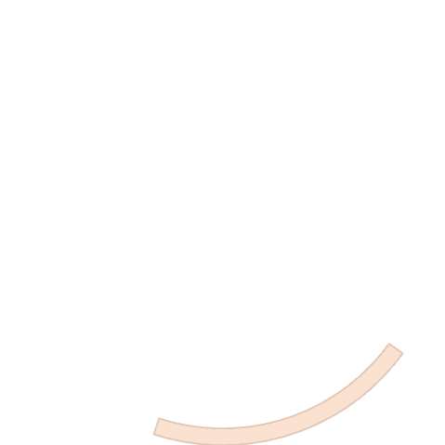
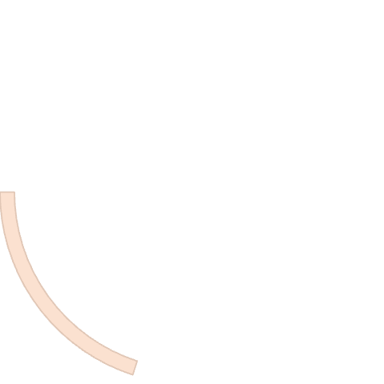




alignItems Property
flex-start
stretch
Items are aligned to the start of the cross axis
Items stretch to fill the container along the cross axis (default)
center
Items are centered along the cross axis
baseline
flex-end
Items are aligned by their text baselines
Items are aligned to the end of the cross axis

Slide 8
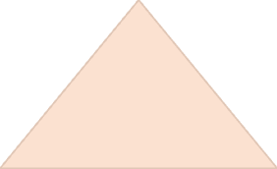

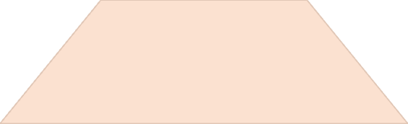
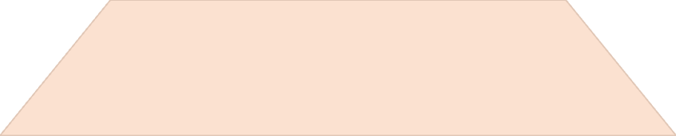

flex Property
flex: 1
Item takes all available space proportionally
flex: 2
2
Item takes twice as much space as flex: 1
flex: 0
Item does not grow, only takes necessary space
The flex property determines how items grow or shrink to fill available space. Higher values take proportionally more space.

Slide 9




Combining Flex Properties
Create the container
Define a View with flex: 1
Set the direction
Choose row or column based on your layout needs
Align the content
Use justifyContent and alignItems for precise positioning
Adjust child proportions
Assign flex values to children to control their size ratios

Slide 10
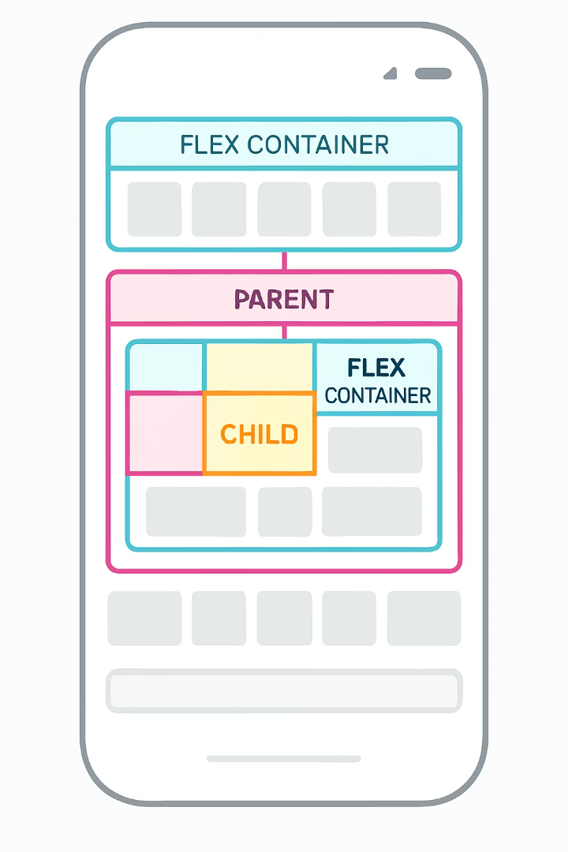
Flexbox Nesting
Create parent container
The outermost View defines the main layout boundaries with flex: 1.
Define section containers
Create child Views that organize content into logical sections.
Add component containers
Each section can contain component Views with their own flex properties.
Position individual elements
The innermost Views contain the actual UI elements to display.

Slide 11
Example: Horizontal layout
import React from 'react';
import { View, StyleSheet } from 'react-native';
const FlexboxExample = () => {
return (
<View style={styles.container}>
<View style={styles.box} />
<View style={styles.box} />
<View style={styles.box} />
</View>
);
};
export default FlexboxExample;
const styles = StyleSheet.create({
container: {
flex: 1,
flexDirection: 'row', // Horizontal layout
justifyContent: 'space-around', // Distribute items evenly
alignItems: 'center', // Center items vertically
backgroundColor: '#F5FCFF',
padding: 20,
},
box: {
width: 80,
height: 80,
backgroundColor: '#3498db',
borderRadius: 4,
},
});

Slide 12
Example: Vertical layout
import React from 'react';
import { View, StyleSheet } from 'react-native';
const VerticalFlexboxExample = () => {
return (
<View style={styles.container}>
<View style={styles.box} />
<View style={styles.box} />
<View style={styles.box} />
</View>
);
};
export default VerticalFlexboxExample;
const styles = StyleSheet.create({
container: {
flex: 1,
flexDirection: 'column', // Vertical layout (this is default, so could be omitted)
justifyContent: 'space-around', // Distribute items evenly
alignItems: 'center', // Center items horizontally
backgroundColor: '#F5FCFF',
padding: 20,
},
box: {
width: 100,
height: 100,
backgroundColor: '#27ae60', // Green color for the boxes
borderRadius: 4,
marginVertical: 10, // Add some vertical spacing between boxes
},
});

Slide 13
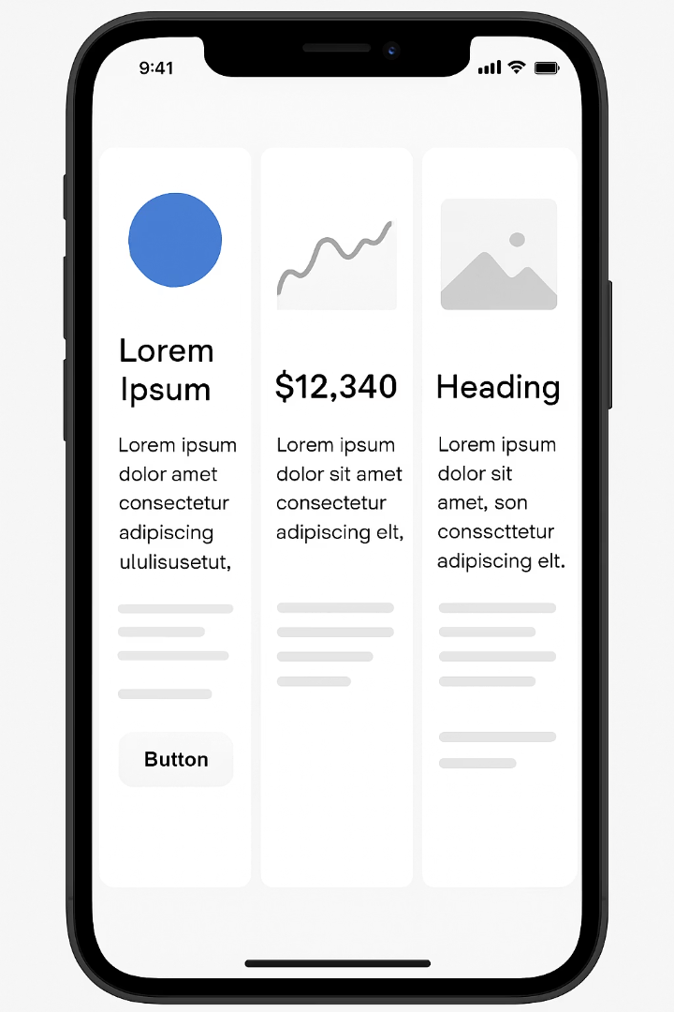
Creating Equal-Width Columns
Container Style
flexDirection: 'row'
Column Style
flex: 1
Spacing
margin: 5
Alignment
alignItems: 'center'
Assign the same flex value (typically 1) to each column. Add margin for spacing. The container should have flexDirection: 'row'.

Slide 14
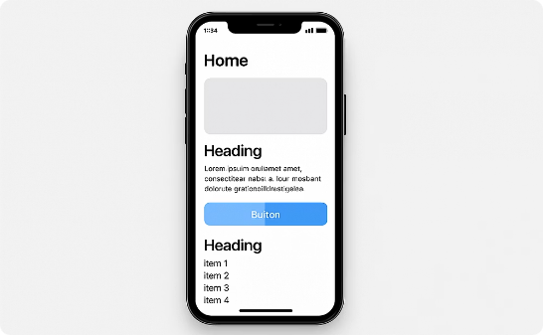
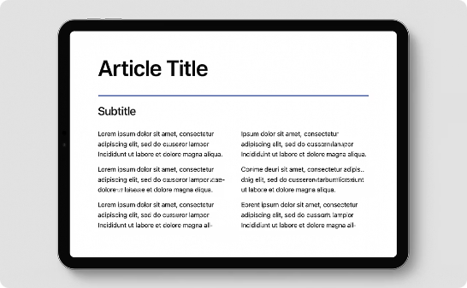
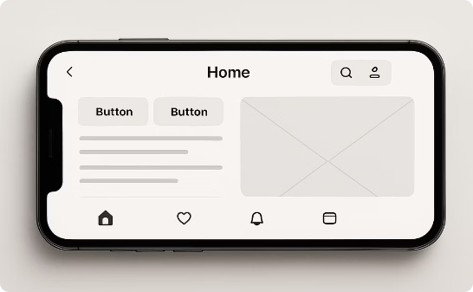
Handling Different Screen Sizes
Small Screens
Tablets
Landscape Orientation
Stack elements vertically. Use flex: 1 sparingly. Focus on critical content.
Use multi-column layouts. Take advantage of additional screen space with expanded content.
Respond to Dimensions API changes. Adjust layouts dynamically when orientation changes.

Slide 15
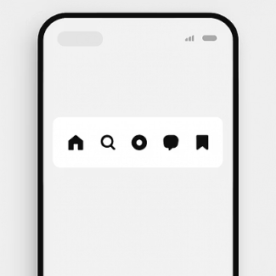
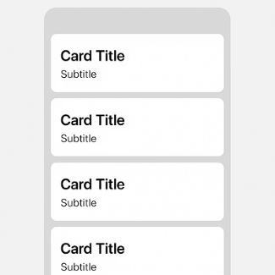
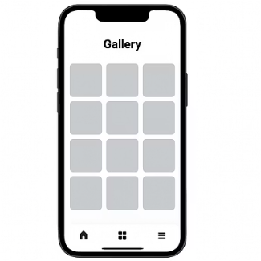
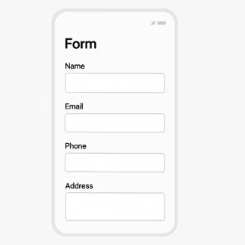
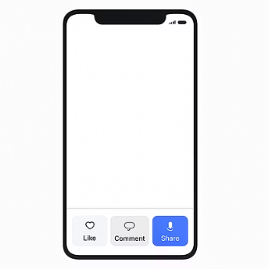
Common Flexbox Patterns
These patterns solve most layout needs in React Native applications. Master them for efficient UI development.

Slide 16
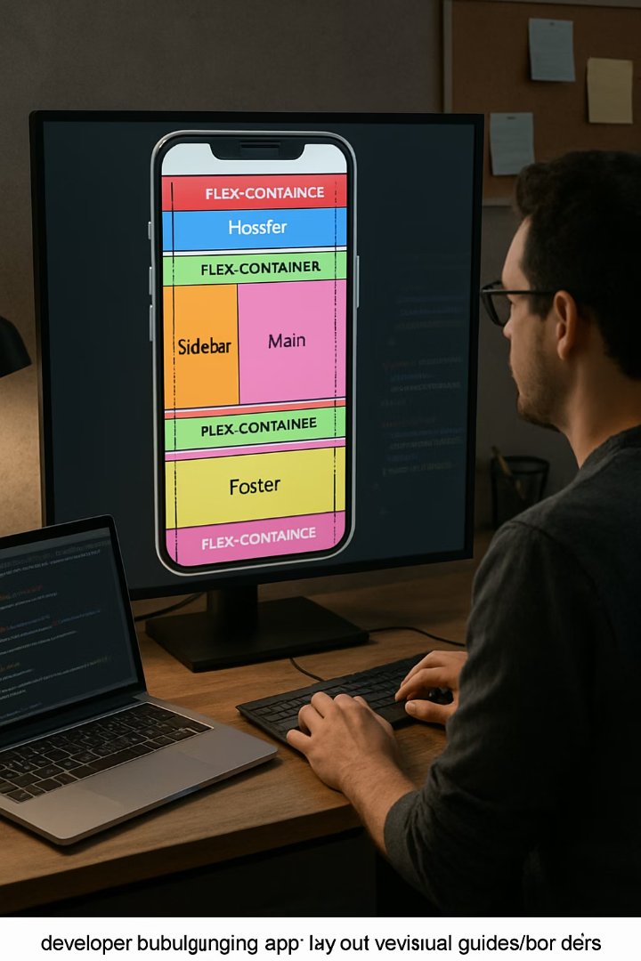



Debugging Flexbox Layouts
Add borders
Set borderWidth: 1 and different borderColors to visualize container boundaries.
Check flex values
Verify flex values are appropriate for desired layout proportions.
3
Test on multiple devices
Check layouts on different screen sizes to ensure responsiveness.
Use React DevTools
Inspect component hierarchy and style properties during development.

Slide 17
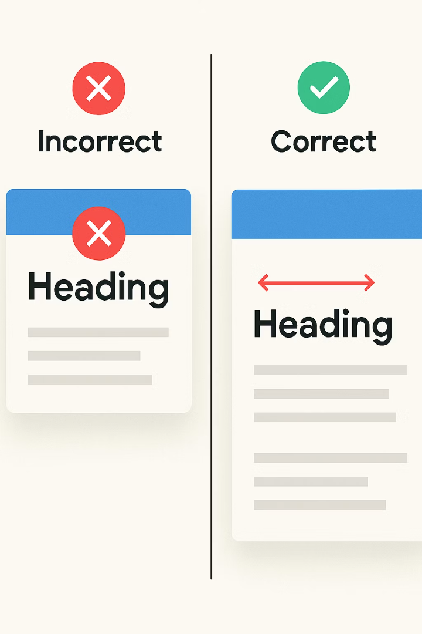




Common Flexbox Mistakes
Forgetting flex: 1
Container views need flex: 1 to fill available space. Without it, they may collapse.
Mixing flexDirection
Confusing which direction justifyContent and alignItems apply to based on direction.
Platform differences
Some flexbox behaviors differ between iOS and Android. Test on both.
Overusing fixed dimensions
Relying too much on fixed widths and heights instead of flex proportions.

Slide 18
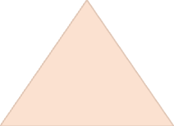

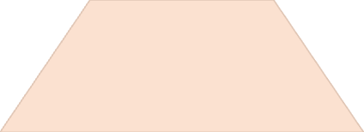

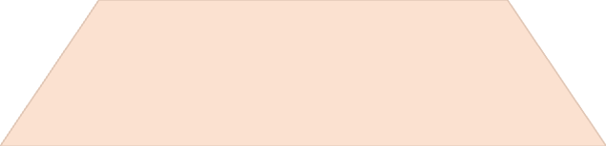

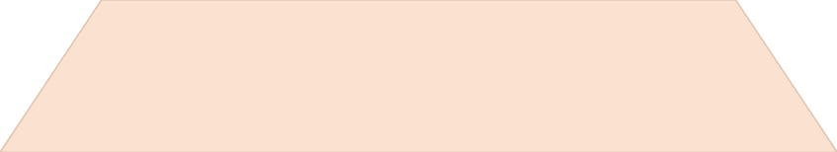

Next Steps for Mastering Layouts
Master Advanced Patterns
Learn complex layouts like animated transitions and parallax effects
Build Real-World Components
Create reusable UI component libraries with flexible layouts
Study Design Principles
Understand UI/UX best practices to inform your layout decisions
Practice Common Patterns
Implement the patterns from this presentation in your own apps

